Slide 1
40

Slide 2
Concept Question 19.1 Monopoles
Can you separate the magnetic “charge centers” into positive and negative charges like we did with electricity?
a) Yes, they are called monopoles
b) No, no one has ever found a monopole
We don’t know for sure
Maybe all of the above

Slide 3
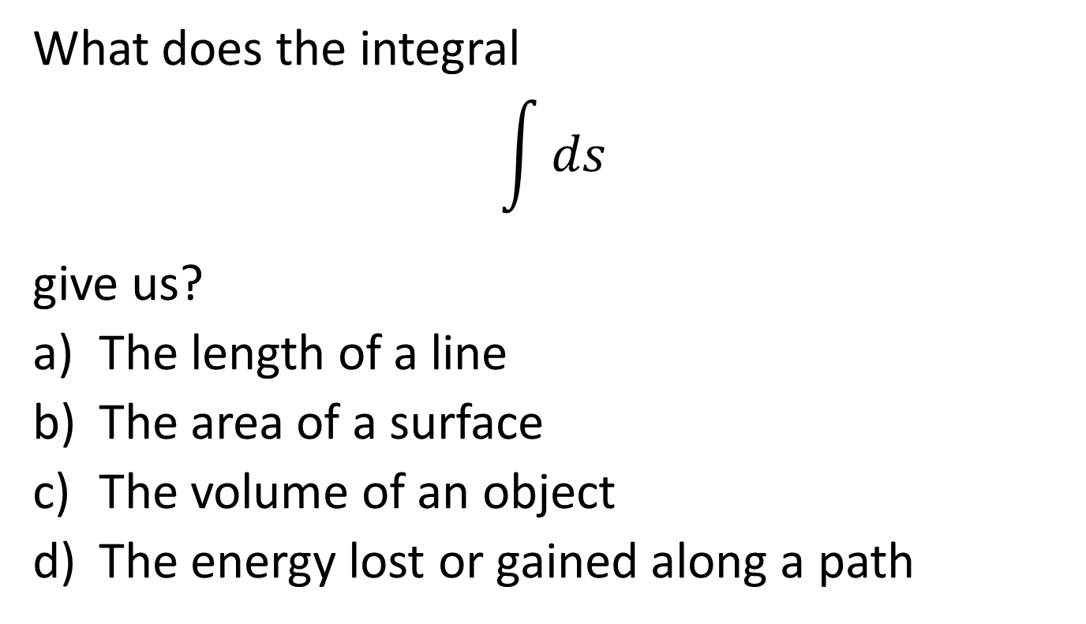
Question
What does the integral
$$\int{ds}$$
give us?
The length of a line
The area of a surface
The volume of an object
The energy lost or gained along a path

Slide 5
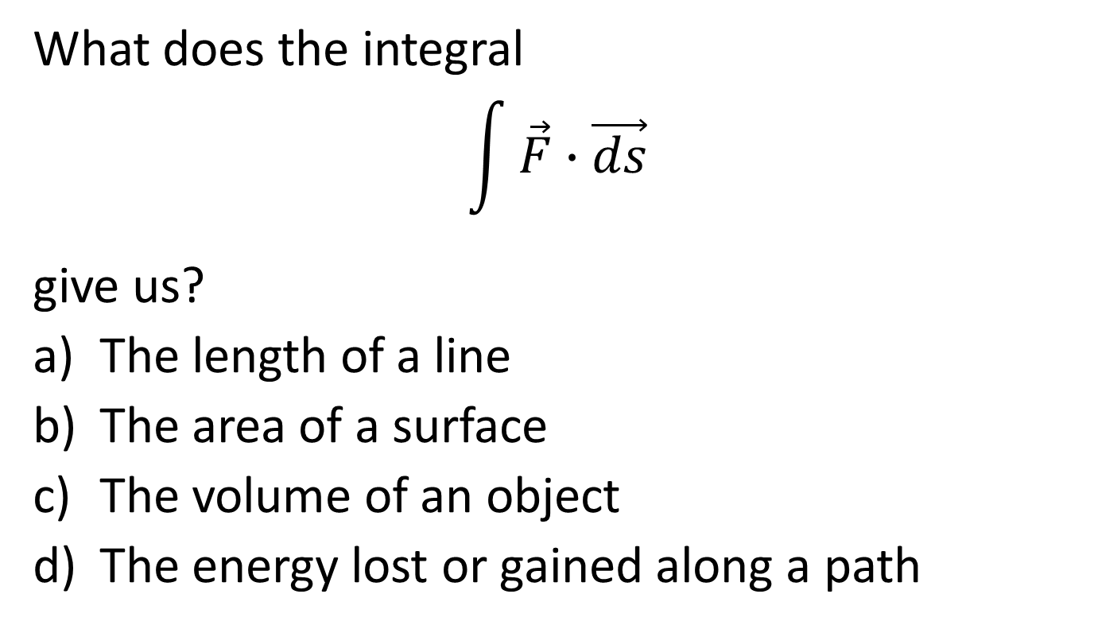
Question
What does the integral
$$\int{\vec{F}∙\vec{ds}}$$
give us?
The length of a line
The area of a surface
The volume of an object
The energy lost or gained along a path

Slide 6
B
b
B
ds
a

Slide 7
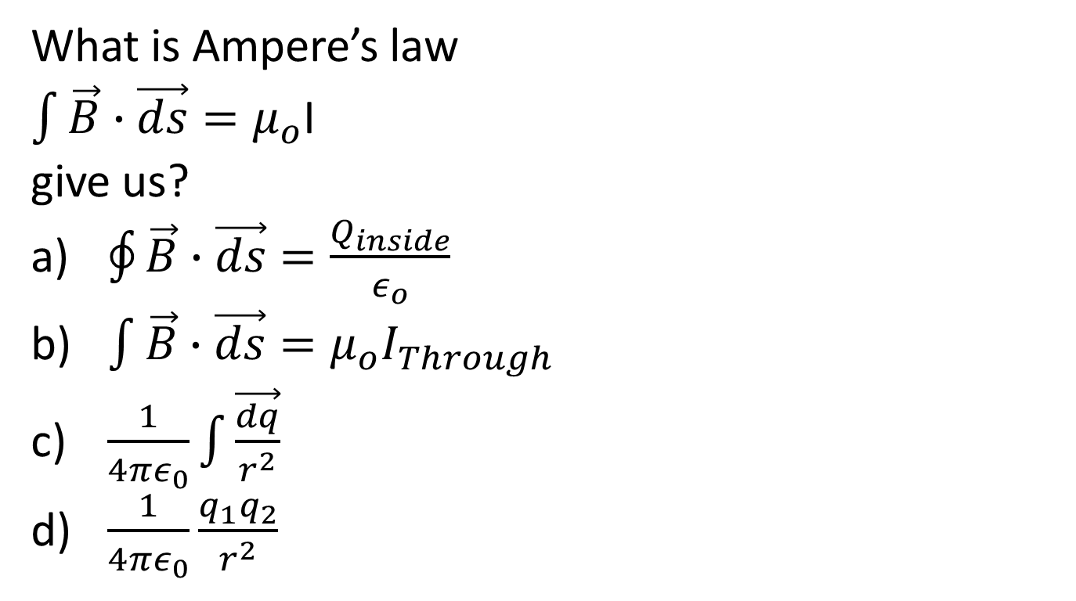
Question
What is Ampere’s law
$\int{\vec{B}∙\vec{ds}}=μ_{o}$I
give us?
$\oint{\vec{B}∙\vec{ds}}=\frac{Q_{inside}}{ε_{o}}$
$\int{\vec{B}∙\vec{ds}}=μ_{o}I_{Through}$
$\frac{1}{4πε_{0}}\int{\vec{\frac{dq}{r^{2}}}}$
$\frac{1}{4πε_{0}}\frac{q_{1}q_{2}}{r^{2}}$

Slide 8


ds
B

Slide 9
Top View

Slide 10
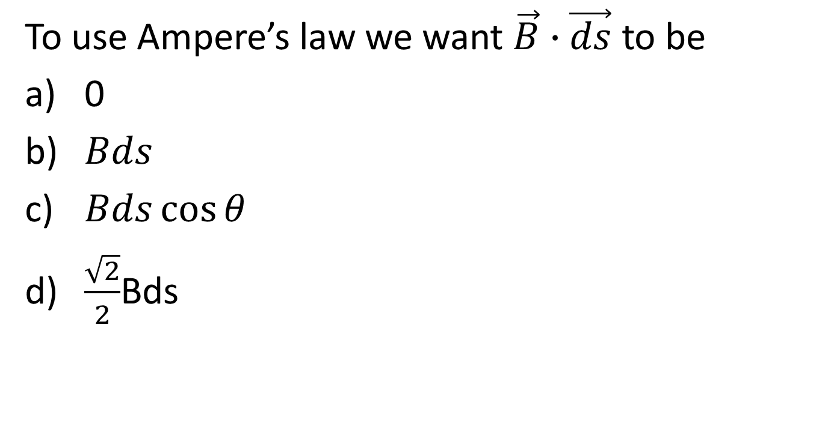
Question
To use Ampere’s law we want $\vec{B}∙\vec{ds}$ to be
0
$Bds$
$Bds\cos{θ}$
$\frac{\sqrt{2}}{2}$Bds

Slide 11
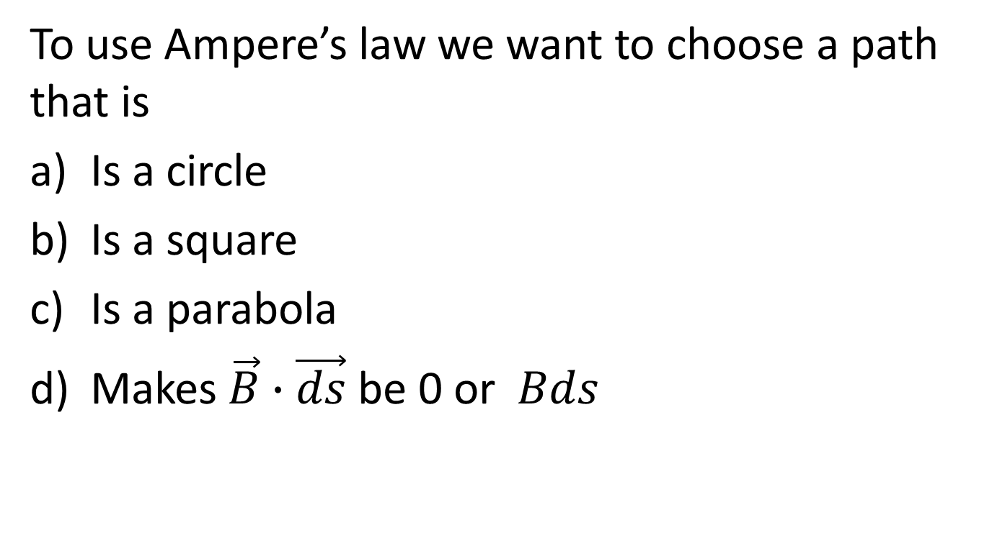
Question
To use Ampere’s law we want to choose a path that is
Is a circle
Is a square
Is a parabola
Makes $\vec{B}∙\vec{ds}$ be 0 or $Bds$

Slide 12
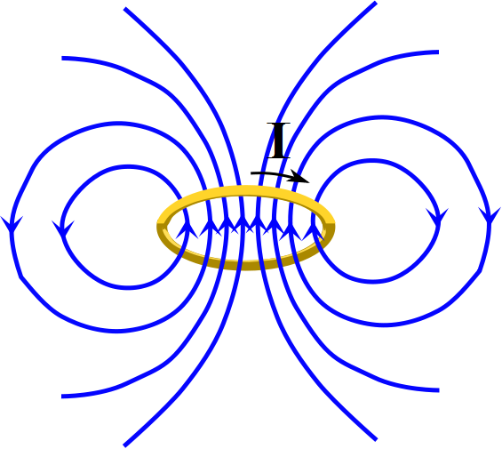

Slide 13
2
1
3
4

Slide 14
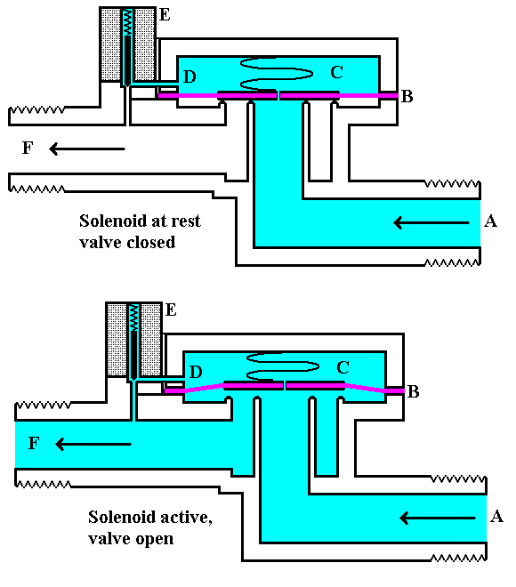

Slide 15
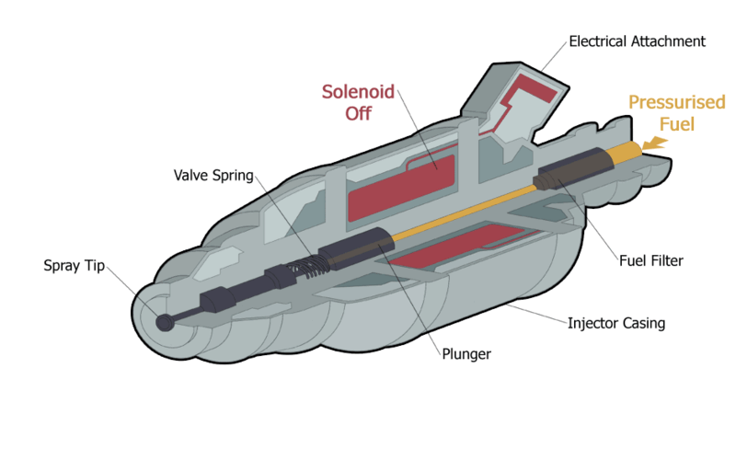
Fuel Injector notional design
WikipedianProlific at en.wikipedia
CC SSA 3.0

Slide 16
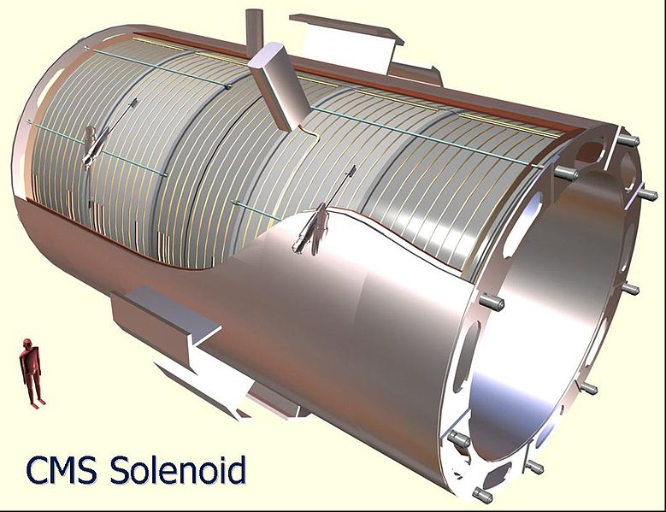

Slide 17
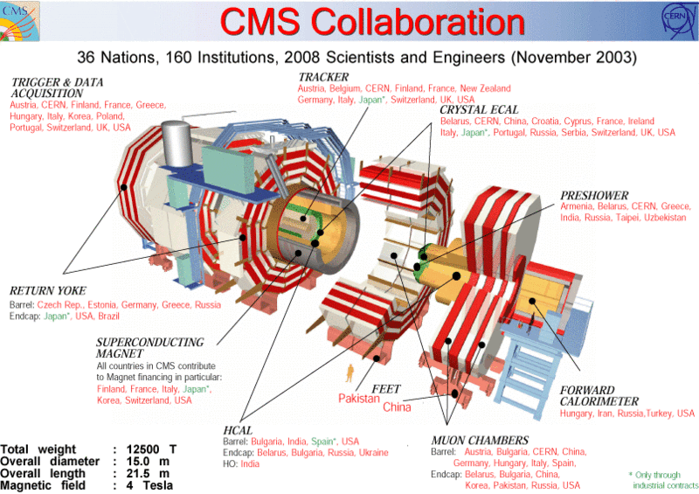

Slide 18
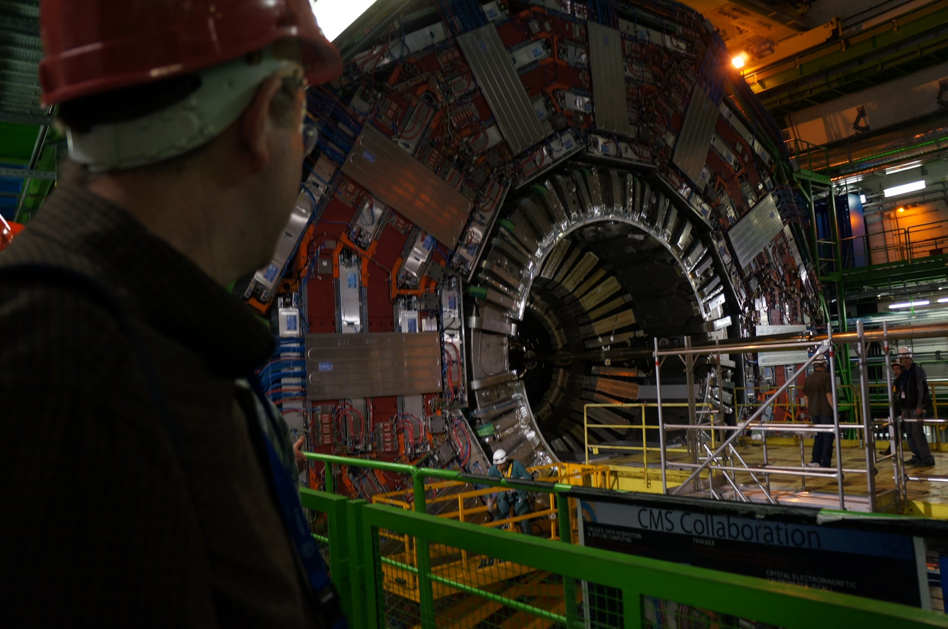

Slide 19
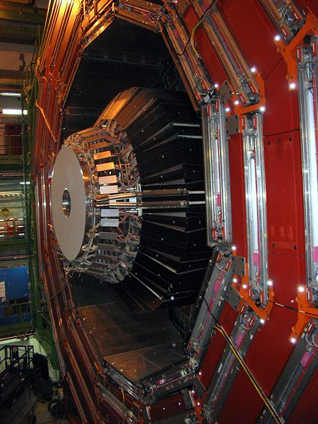

Slide 20
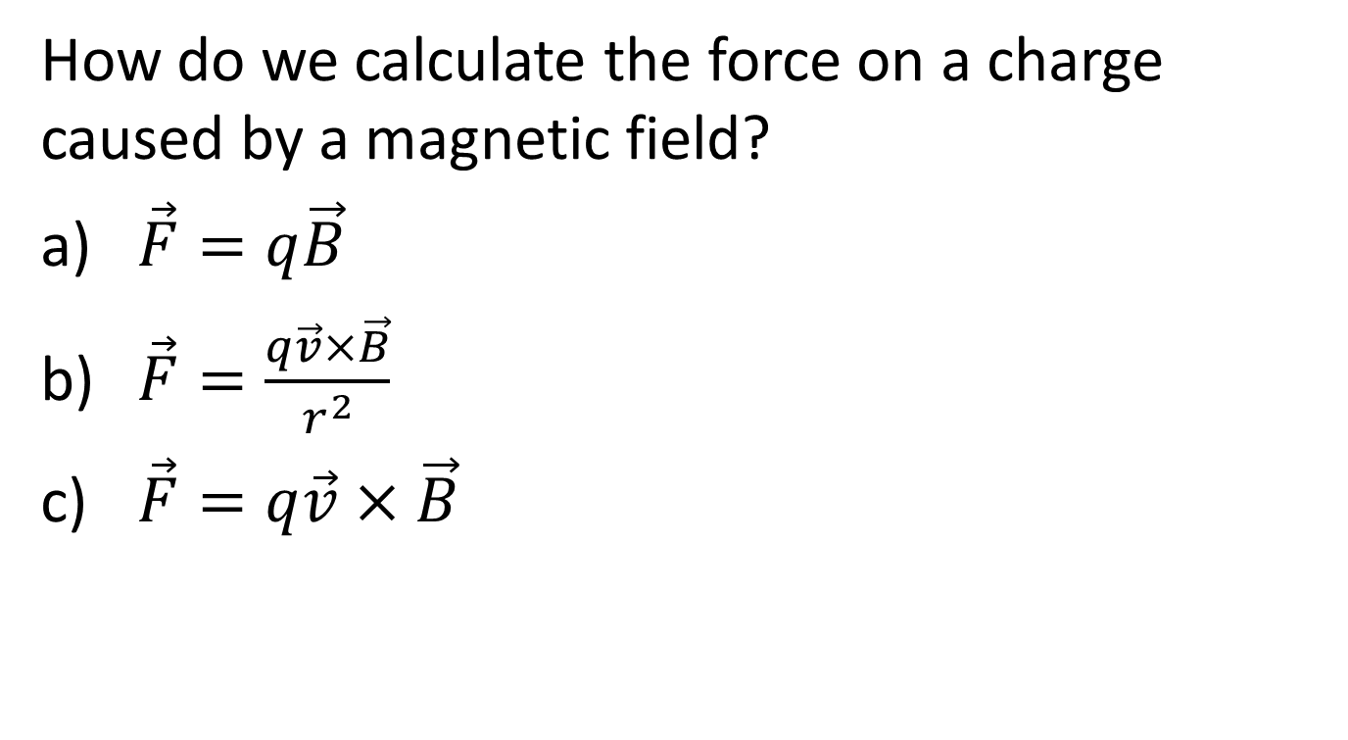
Question
How do we calculate the force on a charge caused by a magnetic field?
$\vec{F}=q\vec{B}$
$\vec{F}=\frac{q\vec{v}×\vec{B}}{r^{2}}$
$\vec{F}=q\vec{v}×\vec{B}$

Slide 21
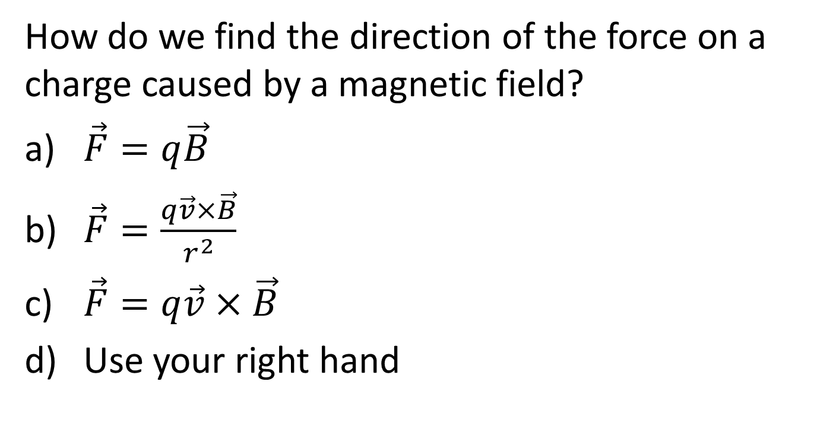
Question
How do we find the direction of the force on a charge caused by a magnetic field?
$\vec{F}=q\vec{B}$
$\vec{F}=\frac{q\vec{v}×\vec{B}}{r^{2}}$
$\vec{F}=q\vec{v}×\vec{B}$
Use your right hand

Slide 22
Angle θ
F
B
θ
v

Slide 23
Question 223.40.1
A positive charge enters a uniform magnetic field as shown. What is the direction of the magnetic force?
1) out of the page
2) into the page
3) downwards
4) to the right
5) to the left
x x x x x x
x x x x x x
x x x x x x
v
q

Slide 24
Question 223.40.1
A positive charge enters a uniform magnetic field as shown. What is the direction of the magnetic force?
1) out of the page
2) into the page
3) downwards
4) to the right
5) to the left
Using the right-hand rule, you can see that the magnetic force is directed to the left. Remember that the magnetic force must be perpendicular to BOTH the B field and the velocity.
x x x x x x
x x x x x x
x x x x x x
v
F
q

Slide 25
Question 223.40.2
A negative charge enters a uniform magnetic field as shown. What is the direction of the magnetic force?
1) out of the page
2) into the page
3) downwards
4) to the right
5) to the left
x x x x x x
x x x x x x
x x x x x x
v
q

Slide 26
Question 223.40.2
A positive charge enters a uniform magnetic field as shown. What is the direction of the magnetic force?
1) out of the page
2) into the page
3) downwards
4) to the right
5) to the left
Using the right-hand rule, you can see that the magnetic force is directed to the left. Remember that the magnetic force must be perpendicular to BOTH the B field and the velocity.
x x x x x x
x x x x x x
x x x x x x
v
q
F

Slide 27
Question 223.40.3
A positive charge enters a uniform magnetic field as shown. What is the direction of the magnetic force?
1) out of the page
2) into the page
3) downwards
4) upwards
5) to the left
x x x x x x
x x x x x x
x x x x x x
v
q

Slide 28
Question 223.40.3
A positive charge enters a uniform magnetic field as shown. What is the direction of the magnetic force?
1) out of the page
2) into the page
3) downwards
4) upwards
5) to the left
Using the right-hand rule, you can see that the magnetic force is directed upwards. Remember that the magnetic force must be perpendicular to BOTH the B field and the velocity.
x x x x x x
x x x x x x
x x x x x x
F
v
q

Slide 29
Question 223.40.4
A positive charge enters a uniform magnetic field as shown. What is the direction of the magnetic force?
1) out of the page
2) into the page
3) zero
4) to the right
5) to the left
→ → → → →
→ → → → →
v
→ → → → →
→ → → → →
q

Slide 30
Question 223.40.4
A positive charge enters a uniform magnetic field as shown. What is the direction of the magnetic force?
1) out of the page
2) into the page
3) zero
4) to the right
5) to the left
Using the right-hand rule, you can see that the magnetic force is directed into the page. Remember that the magnetic force must be perpendicular to BOTH the B field and the velocity.
→ → → → →
→ → → → →
v
→ → → → →
→ → → → →
F
×
q

Slide 31
Question 223.40.5
A positive charge enters a uniform magnetic field as shown. What is the direction of the magnetic force?
1) out of the page
2) into the page
3) zero
4) to the right
5) to the left
v
q

Slide 32
Question 223.40.5
A positive charge enters a uniform magnetic field as shown. What is the direction of the magnetic force?
1) out of the page
2) into the page
3) zero
4) to the right
5) to the left
The charge is moving parallel to the magnetic field, so it does not experience any magnetic force. Remember that the magnetic force is given by: F = v B sin(θ) .
v
q
F = 0

Slide 33
Charge in B-field Setup
v
F
+

Slide 34
Question 223.40.6
If the force on an object is perpendicular to the direction the object is traveling, what happens?
The object turns
The object speeds up
The object slows down
The object motion does not change

Slide 35
Charge in B-field
+
v
F
v
F
+

Slide 36
+

Slide 37
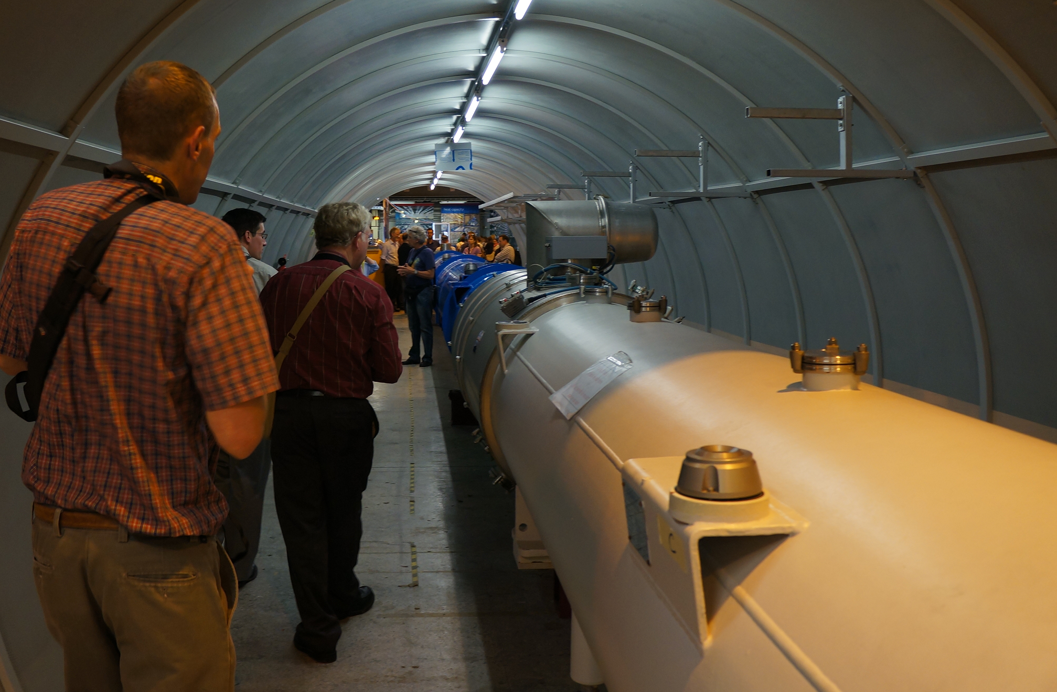

Slide 38
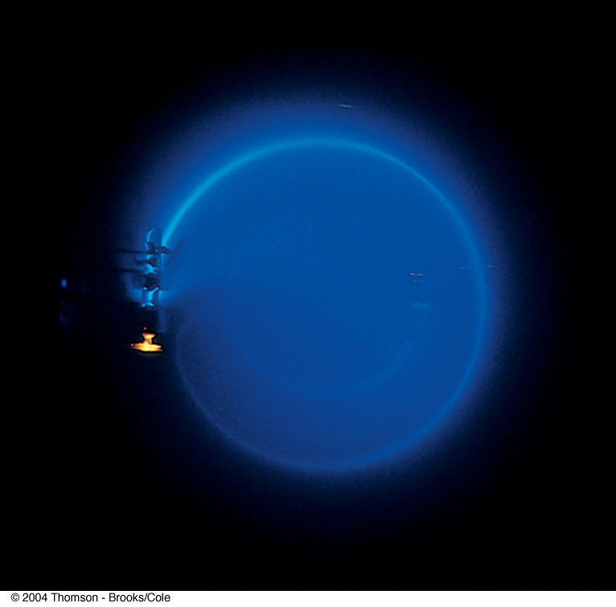
Bending of an Electron Beam

Slide 39
Question 223.40.7
A proton beam enters into a magnetic field region as shown below. What is the direction of the magnetic field B?
1) + y
2) – y
3) + x
4) + z (out of page)
5) – z (into page)
y
x

Slide 40
Question 223.40.7
A proton beam enters into a magnetic field region as shown below. What is the direction of the magnetic field B?
1) + y
2) – y
3) + x
4) + z (out of page)
5) – z (into page)
The picture shows the force acting in the +y direction. Applying the right-hand rule leads to a B field that points into the page. The B field must be out of the plane because B ⊥ v and B ⊥ F.
y
x
Follow-up: What would happen to a beam of atoms?

Slide 41
Question 223.40.8
x x x x x x x x x x x x
x x x x x x x x x x x x
x x x x x x x x x x x x
x x x x x x x x x x x x
x x x x x x x x x x x x
x x x x x x x x x x x x
Two particles of the same mass enter a magnetic field with the same speed and follow the paths shown. Which particle has the bigger charge?
1
2
3) both charges are equal
4) impossible to tell from the picture

Slide 42
Question 223.40.8
x x x x x x x x x x x x
x x x x x x x x x x x x
x x x x x x x x x x x x
x x x x x x x x x x x x
x x x x x x x x x x x x
x x x x x x x x x x x x
Two particles of the same mass enter a magnetic field with the same speed and follow the paths shown. Which particle has the bigger charge?
1
2
3) both charges are equal
4) impossible to tell from the picture
The relevant equation for us is:
According to this equation, the
bigger the charge, the smaller the radius.
Follow-up: What is the sign of the charges in the picture?

Slide 43
Question 223.40.9
A proton enters a uniform magnetic field that is perpendicular to the proton’s velocity. What happens to the kinetic energy of the proton?
1) it increases
2) it decreases
3) it stays the same
4) depends on the velocity direction
5) depends on the B field direction
x x x x x x x x x x x x
x x x x x x x x x x x x
x x x x x x x x x x x x
x x x x x x x x x x x x
x x x x x x x x x x x x

Slide 44
Question 223.40.9
A proton enters a uniform magnetic field that is perpendicular to the proton’s velocity. What happens to the kinetic energy of the proton?
1) it increases
2) it decreases
3) it stays the same
4) depends on the velocity direction
5) depends on the B field direction
The velocity of the proton changes direction but the magnitude (speed) doesn’t change. Thus the kinetic energy stays the same.
x x x x x x x x x x x x
x x x x x x x x x x x x
x x x x x x x x x x x x
x x x x x x x x x x x x
x x x x x x x x x x x x

Slide 45
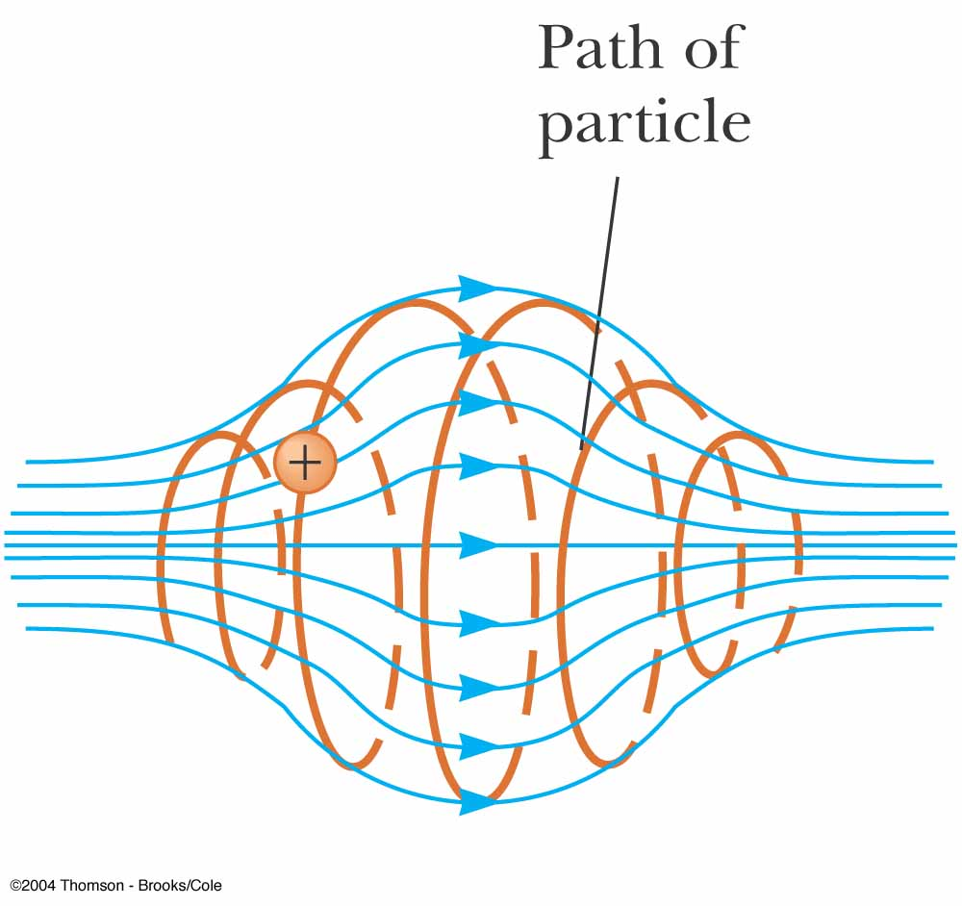

Slide 46
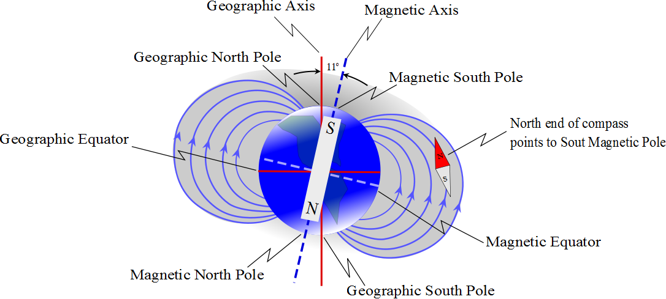
+

Slide 47


Slide 48
B
Source
v
+
E
Slit

Slide 49
what is the velocity of a charged particle that travels through the field without being deflected?
B
Source
v
+
E
Slit

Slide 50
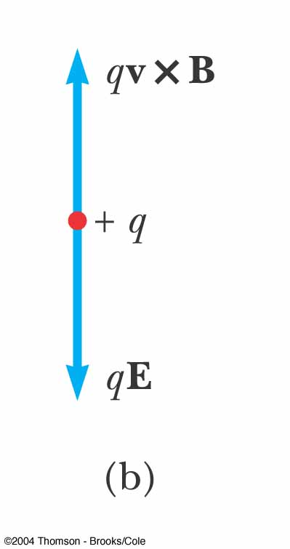
Velocity Selector, cont.
When the force due to the electric field is equal but opposite to the force due to the magnetic field, the particle moves in a straight line
This occurs for velocities of value
v = E / B

Slide 51
Velocity Selector, final
Only those particles with the given speed will pass through the two fields undeflected
The magnetic force exerted on particles moving at speed greater than this is stronger than the electric field and the particles will be deflected upward
Those moving more slowly will be deflected downward

Slide 52
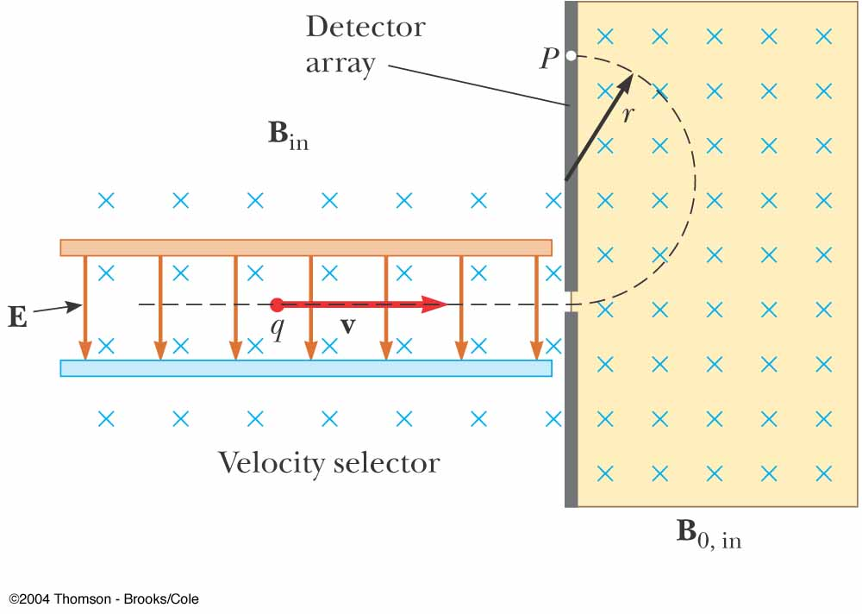
Mass Spectrometer
A mass spectrometer separates ions according to their mass-to-charge ratio
A beam of ions passes through a velocity selector and enters a second magnetic field

Slide 53
Detector
r
B
Source
v
+
E
Slit

Slide 54
Mass Spectrometer, cont.
After entering the second magnetic field, the ions move in a semicircle of radius r before striking a detector at P
If the ions are positively charged, they deflect upward
If the ions are negatively charged, they deflect downward

Slide 55
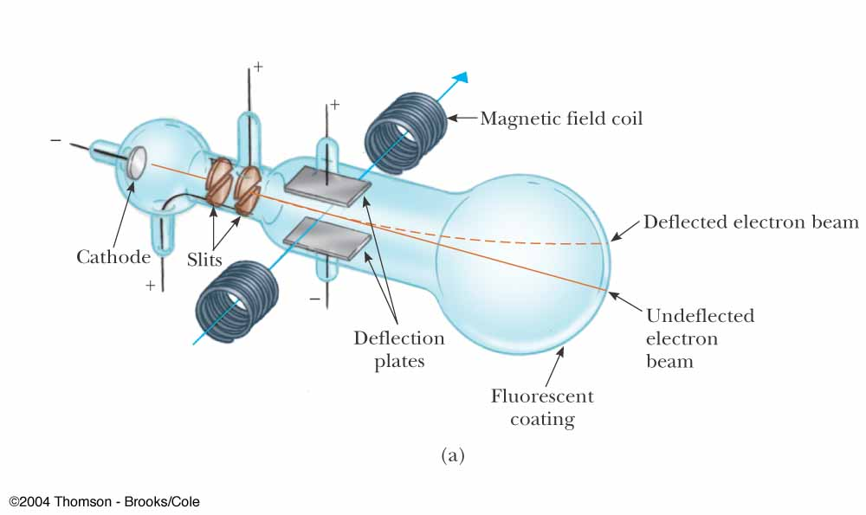
Thomson’s e/m Experiment
Electrons are accelerated from the cathode
They are deflected by electric and magnetic fields
The beam of electrons strikes a fluorescent screen

Slide 56
Thomson’s e/m Experiment, 2
In general, m/q can be determined by measuring the radius of curvature and knowing the magnitudes of the fields
Thomson’s variation found e/m_{e} by measuring the deflection of the beam and the fields

Slide 57
Cyclotron
A cyclotron is a device that can accelerate charged particles to very high speeds
The energetic particles produced are used to bombard atomic nuclei and thereby produce reactions
These reactions can be analyzed by researchers

Slide 58
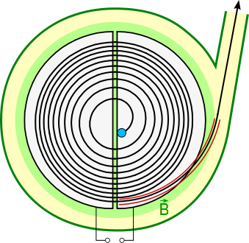
Cyclotron, 2
D₁ and D₂ are called dees because of their shape
A high frequency alternating potential is applied to the dees
A uniform magnetic field is perpendicular to them

Slide 59
Cyclotron, 3
A positive ion is released near the center and moves in a semicircular path
The potential difference is adjusted so that the polarity of the dees is reversed in the same time interval as the particle travels around one dee
This ensures the kinetic energy of the particle increases each trip

Slide 60
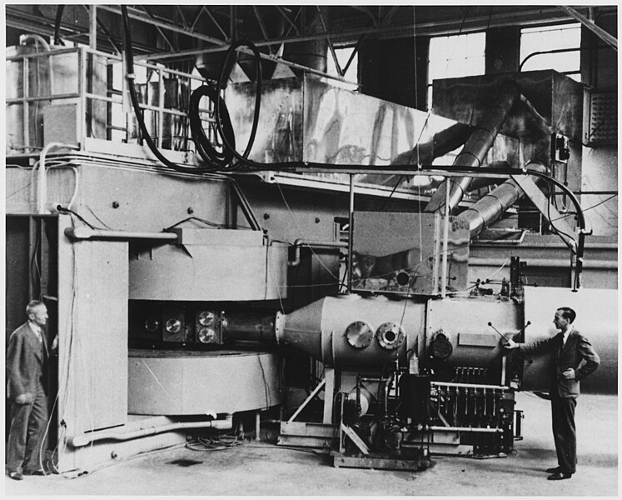

Slide 61
Cyclotron, final
The cyclotron’s operation is based on the fact that T is independent of the speed of the particles and of the radius of their path
When the energy of the ions in a cyclotron exceeds about 20 MeV, relativistic effects come into play

Slide 62
Hall Effect
When a current carrying conductor is placed in a magnetic field, a potential difference is generated in a direction perpendicular to both the current and the magnetic field
This phenomena is known as the Hall effect
It arises from the deflection of charge carriers to one side of the conductor as a result of the magnetic forces they experience

Slide 63
Hall Effect, cont.
The Hall effect gives information regarding the sign of the charge carriers and their density
It can also be used to measure magnetic fields

Slide 64
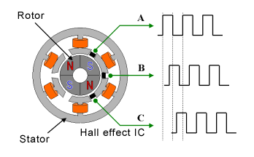
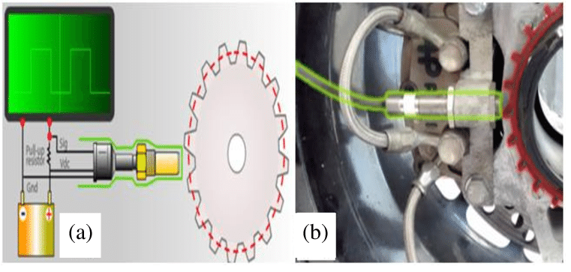
https://www.eeweb.com/detection-of-brushless-motor-rotation/
https://www.researchgate.net/figure/Schematic-representation-of-the-Hall-effect-sensor-for-measuring-of-the-vehicle-speed-a_fig8_337682868

Slide 65
Hall Voltage
c
a
I

Slide 66
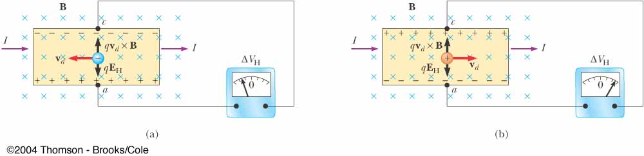
Hall Voltage, cont
When the charge carriers are negative, the upper edge of the conductor becomes negatively charged
When the charge carriers are positive, the upper edge becomes positively charged

Slide 67
Hall Voltage, final
ΔV_{H} = E_{H}d = v_{d} B d
d is the width of the conductor
v_{d} is the drift velocity
If B and d are known, v_{d} can be found
R_{H} = 1 / nq is called the Hall coefficient
A properly calibrated conductor can be used to measure the magnitude of an unknown magnetic field

Slide 68
Question 223.40.10
A beam of atoms enters a magnetic field region. What path will the atoms follow?
1
x x x x x x x x x x x x
x x x x x x x x x x x x
x x x x x x x x x x x x
x x x x x x x x x x x x
x x x x x x x x x x x x
x x x x x x x x x x x x
2
3
4

Slide 69
Question 223.40.10
A beam of atoms enters a magnetic field region. What path will the atoms follow?
1
x x x x x x x x x x x x
x x x x x x x x x x x x
x x x x x x x x x x x x
x x x x x x x x x x x x
x x x x x x x x x x x x
x x x x x x x x x x x x
2
3
4
Atoms are neutral objects whose net charge is zero. Thus they do not experience a magnetic force.
Follow-up: What charge would follow path #3? What about path #1?

Slide 70
Question 223.40.10
What direction would a B field have to point for a beam of electrons moving to the right to go undeflected through a region where there is a uniform electric field pointing vertically upward?
1) up (parallel to E )
2) down (antiparallel to E )
3) into the page
4) out of the page
5) impossible to accomplish
E
B = ?
electrons
v

Slide 71
Question 223.40.10
What direction would a B field have to point for a beam of electrons moving to the right to go undeflected through a region where there is a uniform electric field pointing vertically upward?
1) up (parallel to E )
2) down (antiparallel to E )
3) into the page
4) out of the page
5) impossible to accomplish
Without a B field, the electrons feel an electric force downwards. In order to compensate, the magnetic force has to point upwards. Using the right-hand rule and the fact that the electrons are negatively charged leads to a B field pointing out of the page.
E
B = ?
electrons
v

